Slide 1
Piezometer Measurements in the District of Padua
Geospatial Data Analysis (053799)- Assignment
Author: Gian Mohammad Arvin
Codice Persona: 10871604
Matricola: 220739
Professor: Venuti Giovanna & De Gaetani Carlo Iapige
Academic Year: 2022-2023

Slide 2
Introduction and Background
Piezometer is used to measure underground water pressure. It converts water pressure to a frequency signal via a diaphragm and a tensioned steel wire. A change in pressure on the diaphragm causes a change in tension of the wire.
The provided time series are referring to piezometer measurements in the district of Padua. They are real data made available by ARPA Veneto, the regional agency for environment protection. The whole dataset is composed by measurements taken between 1999 and 2021 (roughly) from several boreholes, each identified by a numeric ID and whose positions are provided in planar cartographic coordinates. Each time-series covers a different period and although there are approximately sampled 4 times per year, the dates of acquisition are different.

Slide 3
Procedure - Data Description
There are 52 station point
Acquisition date usually start from 1999 to 2021, however some station not start in 1999 or 2021
Usually there are 4 data acquisition/year per station, others only have 0, 1, 2, or 3 data acquisition. However each acquisition date is different periods from one to another
There are 26 station points have no pressure level data at all even though the date acquisition is provided (station point number 975 to 1068)
Station 68 has negative values on pressure level, while others not
Some pressure level data is missing on Station point 56 to 518

Slide 4
Tools
Python Scripting: (index.py → filename)
libraries for helping measurements of the data:
Pandas (working with DataFrames files, excel, csv)
Numpy (array (support for large, multi-dimensional arrays and matrices)
Matplotlib (plotting data 2D and 3D)
2. Google Slides: Presentation purposes
3. Google Sheets: Data manipulation

Slide 5
Procedure - Data Cleaning
Writer uses 3 methods data cleaning for comparison at the end of the result:
METHOD A: Drop all empty data
Every acquisition data that have empty data will be removed from data collection
However, negative value on station 68 is not removed
Challenge:
Dropping the value instead of re-assigning it with some value means that we lose the accuracy of our observation data

Slide 6
Procedure - Data Cleaning
Writer uses 3 methods data cleaning for comparison at the end of the result:
METHOD B: Replace Empty Data by Mean
Every empty acquisition data will be replaced by the observation value mean referenced to the year (So it is not average of all data, only each year). However, if there is no data at all of those year, the data will be removed
Challenge:
The mean value of each year of observation might not be the real average of pressure level corresponding to its year. There is a probability the measured data is a phase when the pressure level reach its highest/lowest point throughout the year

Slide 7
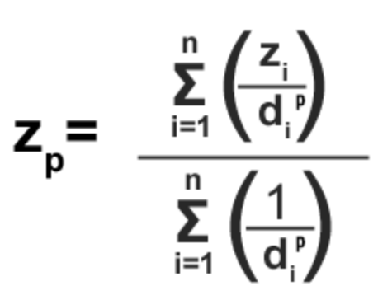
Procedure - Data Cleaning
Writer uses 3 methods data cleaning for comparison at the end of the result:
METHOD C: Spatial Interpolation Method IDW → Weight function
use mathematical (deterministic) assuming closer values are more related than further values with its function.
IDW is used to predict value on Station point from point 975 to 1068, missing values, or other station pressure level that half of them is missing. In the end we will have data from 1999 to 2021 for all station
Since each year there will be 1 - 4 observation acquisition, and different date on each periods, Writer decides to take one data each year by taking it is average, decreasing the accuracy to one year

Slide 8
Procedure - Data Cleaning
Writer uses 3 methods data cleaning for comparison at the end of the result:
METHOD C: Spatial Interpolation Method IDW → Weight function
D = distance, Z = obs value
Might be not a good weight function, because we neglect all internal/external factor of data measurement by only thinking about the correlation of the distance of between two points and the pressure level itself\
The quality of the interpolation result can decrease, if the distribution of sample data points is uneven. Furthermore, maximum and minimum values in the interpolated surface can only occur at sample data points.

Slide 9
Procedure - Data Modelling
Writer use 6 interpolation method for modelling the data
MODEL A: Least Square Smoothing Interpolation
MODEL B: Exact Interpolation → Polynomials of Max Degree = Num of Samples
MODEL C: Exact interpolation → Lagrange
MODEL D: Custom Interpolation → Trigonometric Polynomial
MODEL E: Piecewise Interpolation → Cubic
MODEL F: Grid Knot Spline → Linear or Cubic

Slide 10
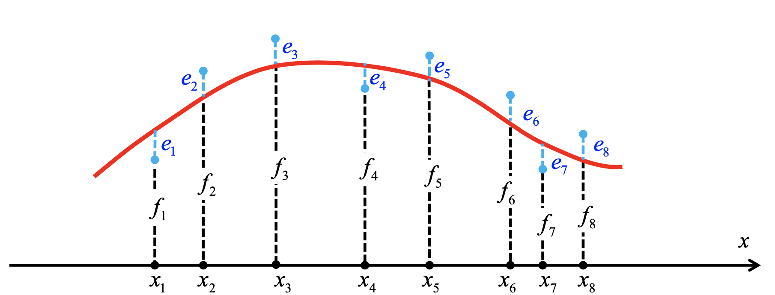

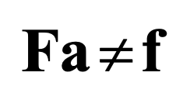
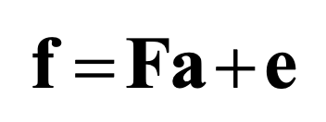
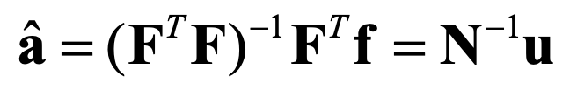
MODEL A: Least Square Smoothing Interpolation

Slide 11
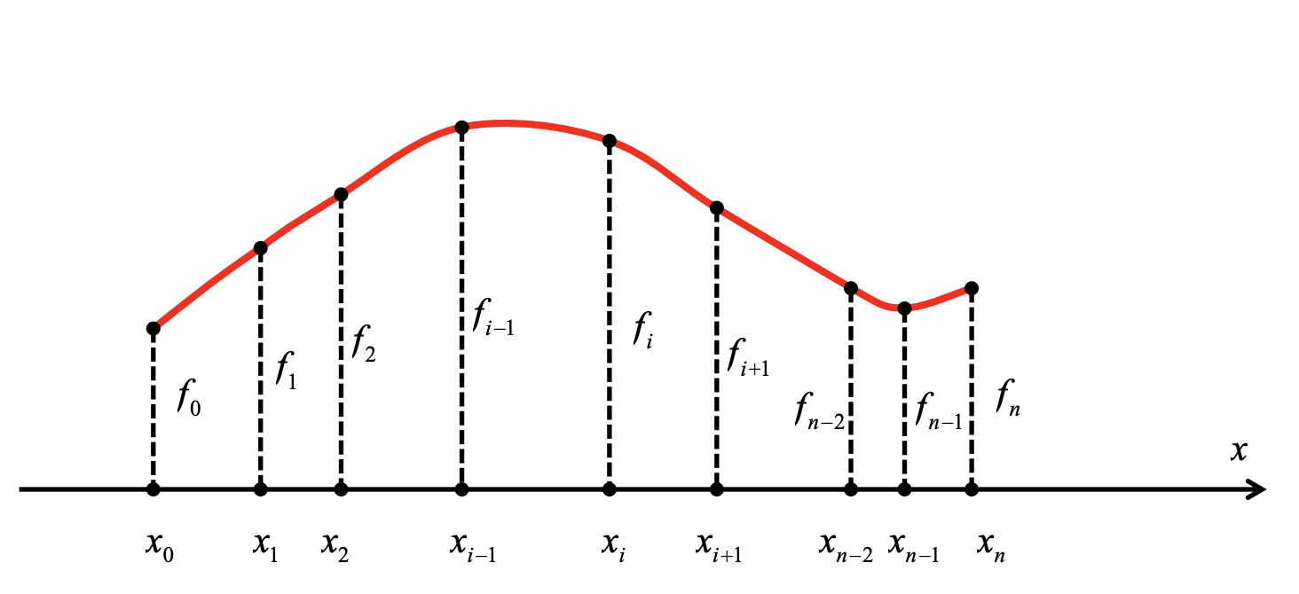
MODEL B: Exact Interpolation -> Polynomial of Max Degree = Num of Sample

Slide 12

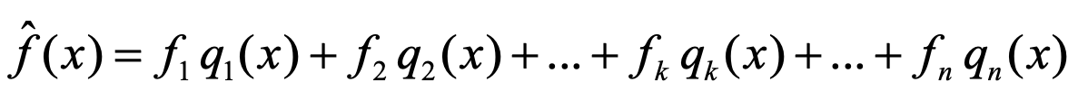
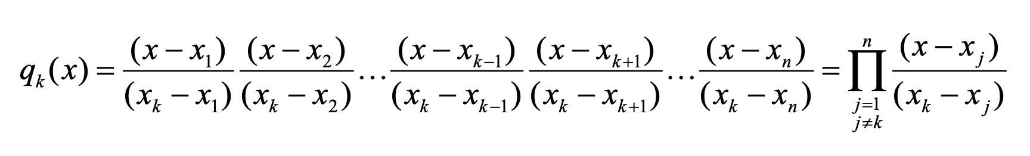
MODEL C: Exact Interpolation -> Lagrange

Slide 13
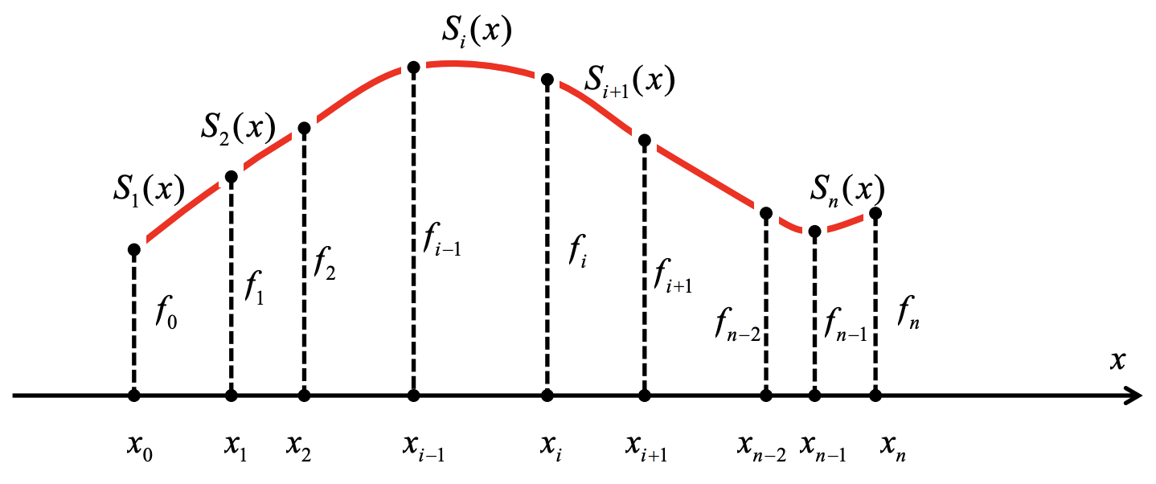
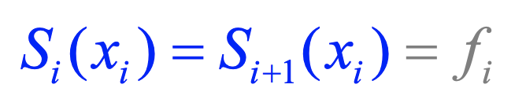
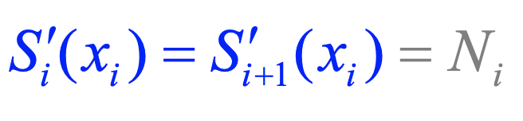
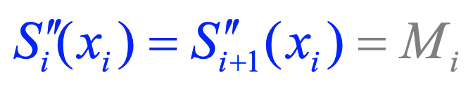
MODEL E: Piecewise Interpolation -> CUBIC
Use a different interpolating function Si (x) for each interval [xi-1, xi ].
Analytical Solution between two interpolation function

Slide 14
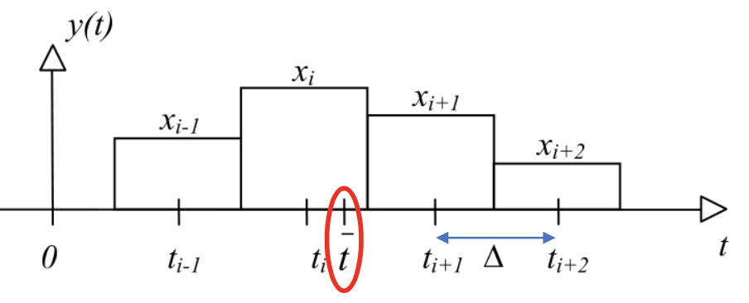
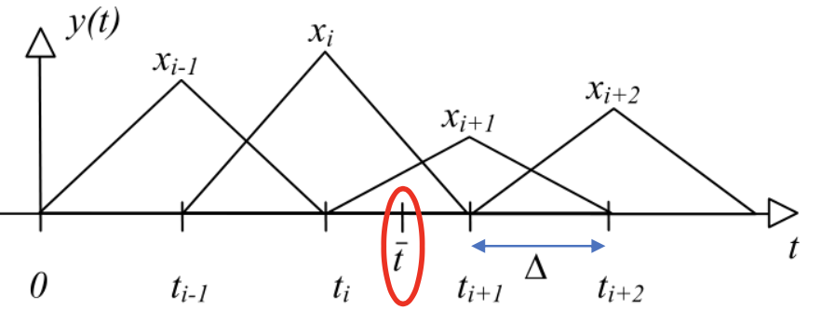
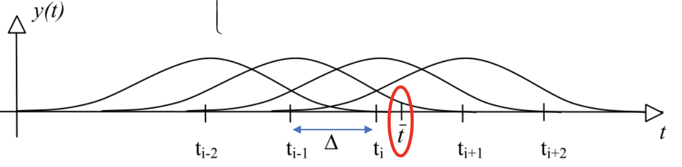
MODEL F: Spline Interpolation with Grid Knot
Box Spline
Linear Spline
Cubic Spline

Slide 15
Step By Step inside Python Script
Create directory and file file:
Code folder:
clean.py → for cleaning and filtering data
constant.py → store all constant variable needed during data manipulation
interpolation.py → store interpolation method function
plot.py → plotting function
index.py → where we start our works
graph folder: store all graph resulted from data calculation
observation_data folder: store our raw data
Report folder → store ppt report
instruction.md → readable instruction to run th script

Slide 16
Step By Step inside Python Script
Read raw data as a pandas Dataframe
Plotting borehole position → result in graph
Data cleaning (do data cleaning based on selected METHOD, group data to each station using HashMap Technique, convert datetime observation data to integer for easier calculation)
Interpolation → based on selected METHOD

Slide 17
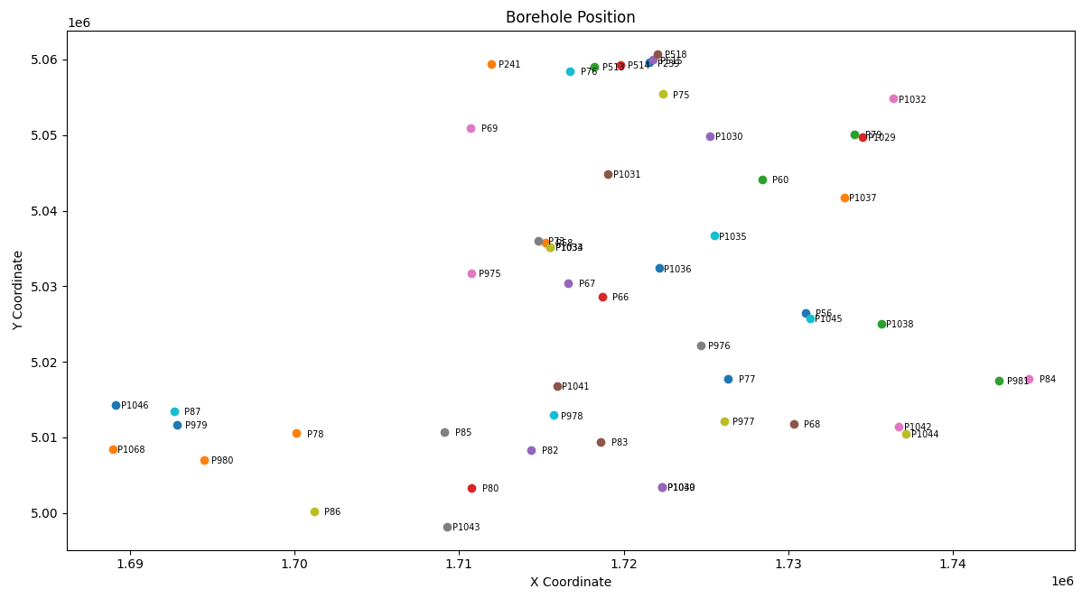
Borehole Position
Figure shown the spread borehole points of Piezzometer station

Slide 18
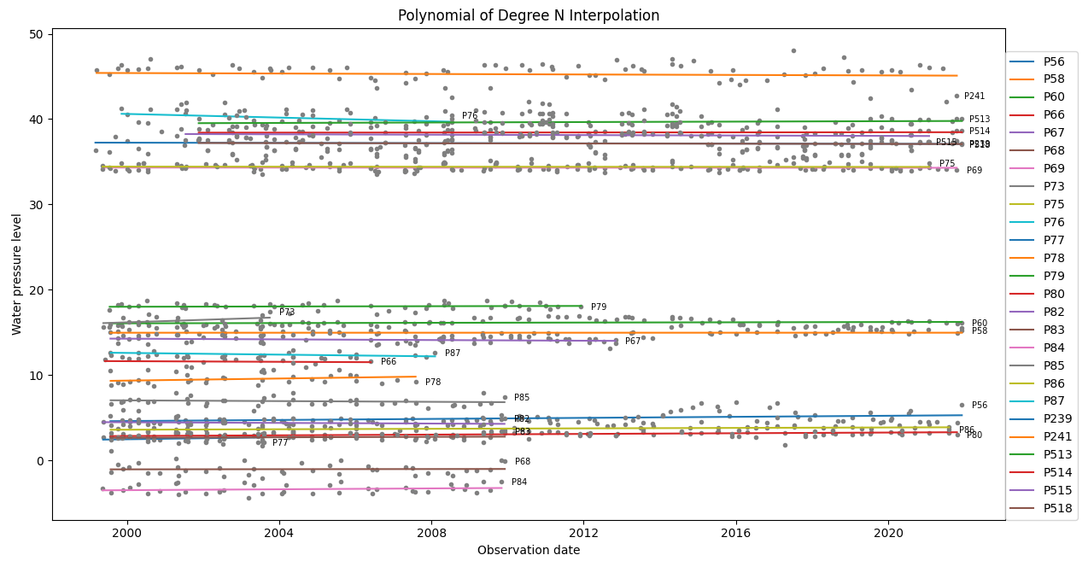
Least Square Smoothing Interpolation - METHOD: Drop Empty
Figure shown Polynomial of Degree 2 → Method: Drop Empty

Slide 19
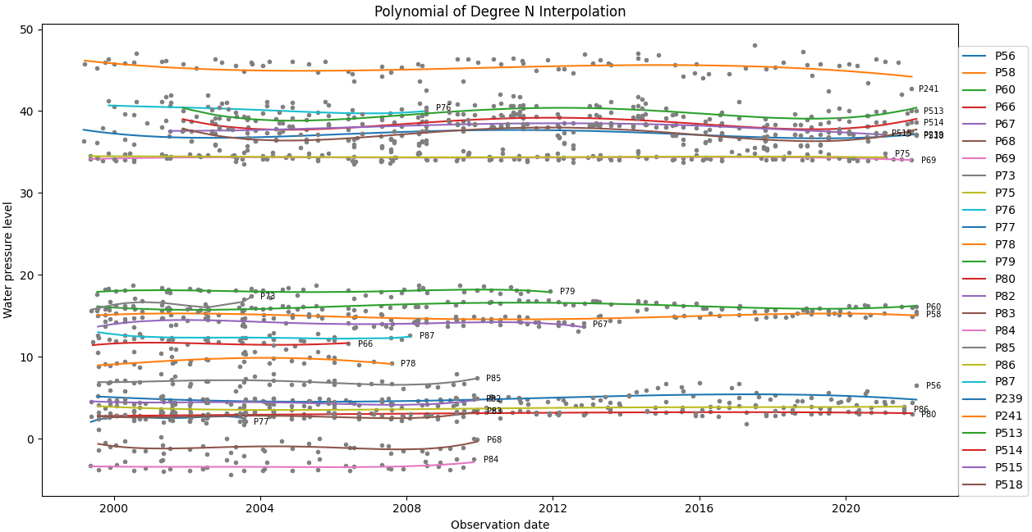
Least Square Smoothing Interpolation - METHOD: Drop Empty
Figure shown Polynomial of Degree 5 → Method: Drop Empty

Slide 20
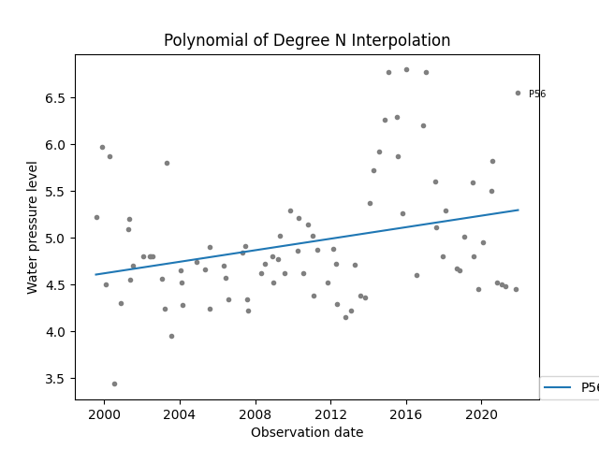
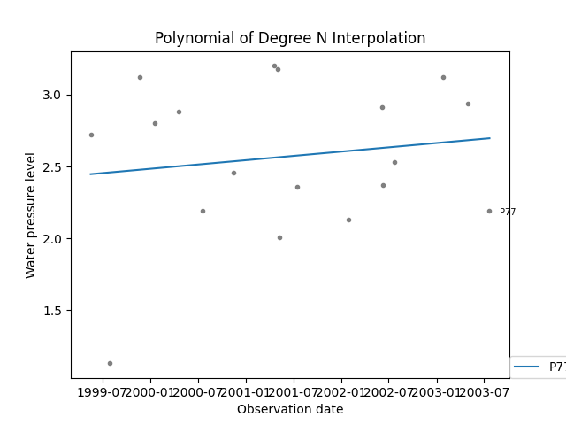
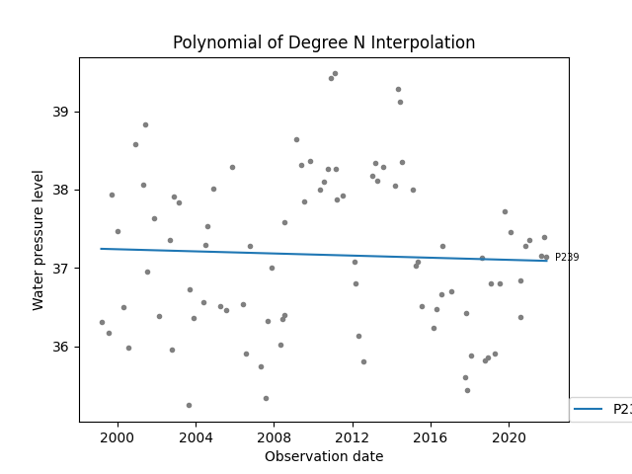
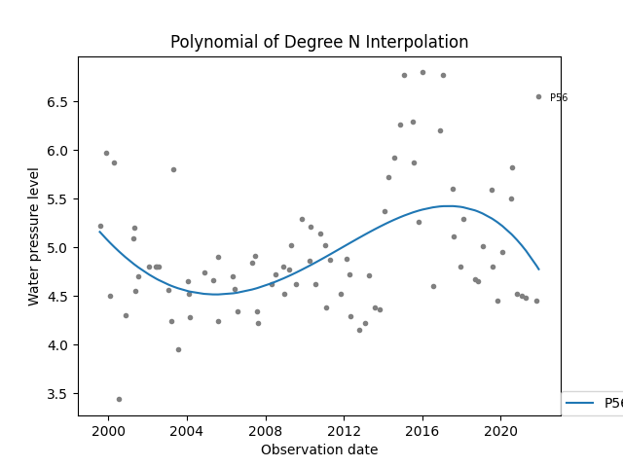
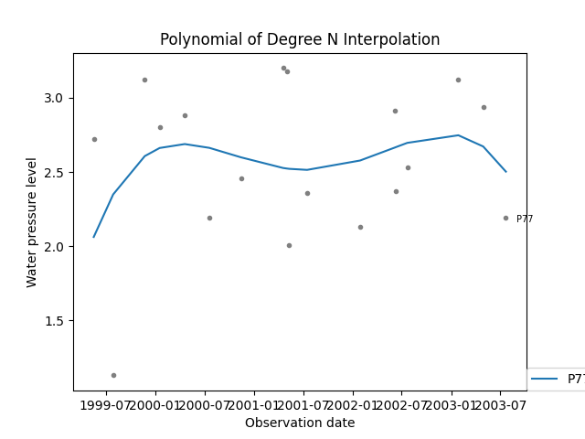
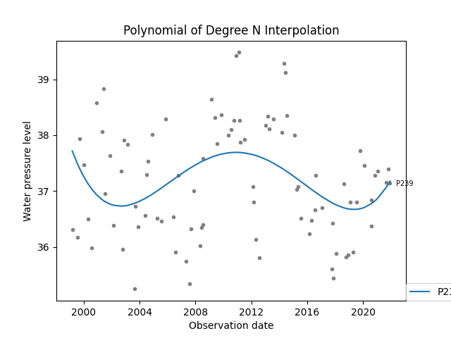
Least Square Smoothing Interpolation - METHOD: Drop Empty
Degree 2
Degree 5
Station 56
Station 77
Station 77
Station 239

Slide 21
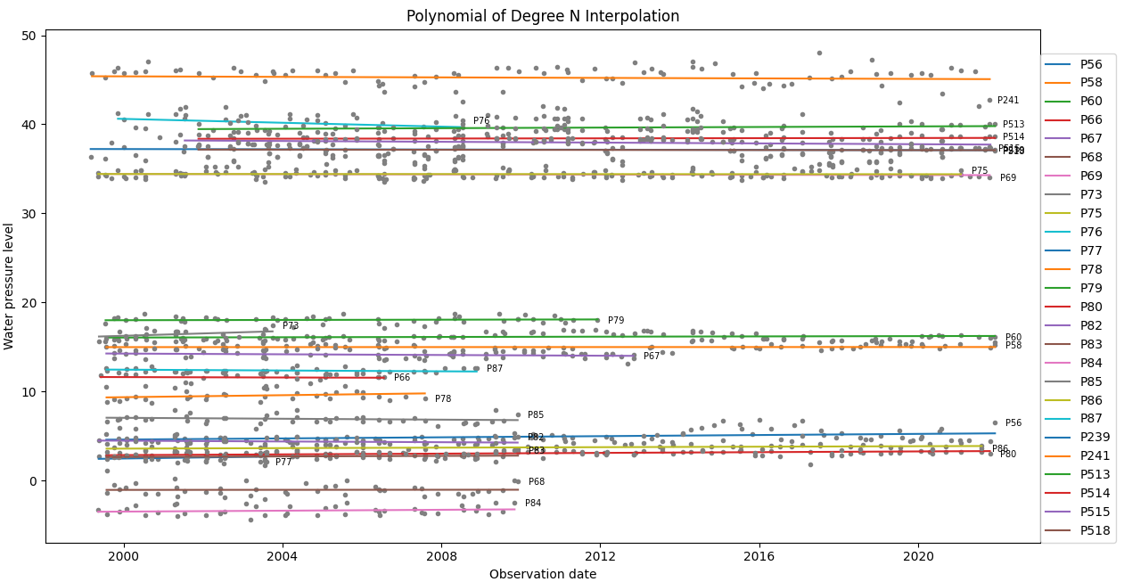
Least Square Smoothing Interpolation - METHOD: Replaced by Mean
Figure shown Polynomial of Degree 2 → Method: Replaced by mean

Slide 22
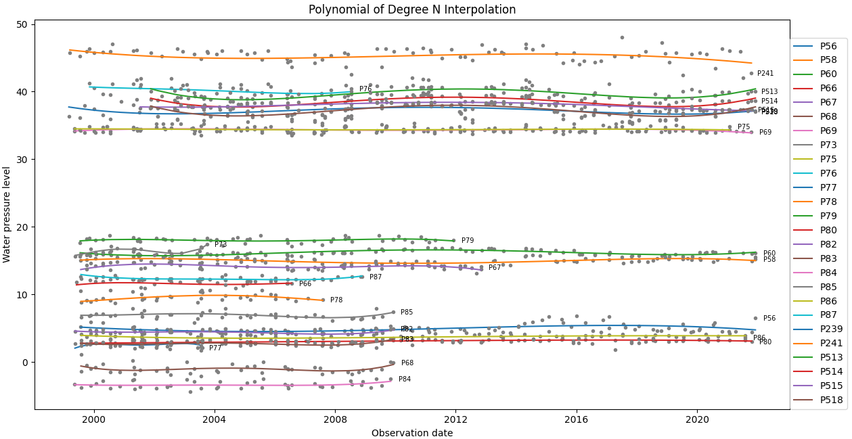
Least Square Smoothing Interpolation - METHOD: Replaced by Mean
Figure shown Polynomial of Degree 5 → Method: Drop Empty

Slide 23
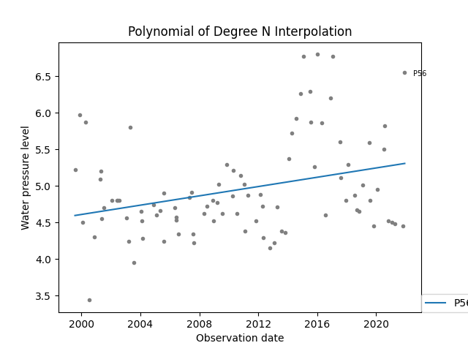

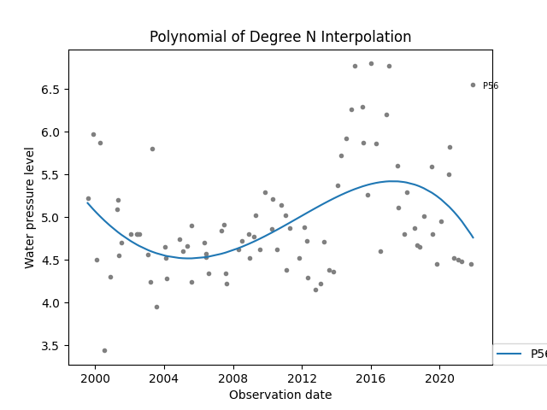
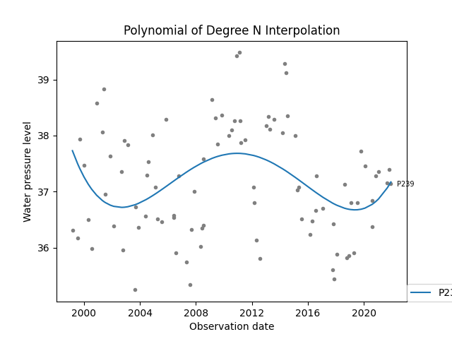
Least Square Smoothing Interpolation - METHOD: Replaced by Mean
Degree 2
Degree 5
Station 56
Station 77
Station 77
Station 239

Slide 24
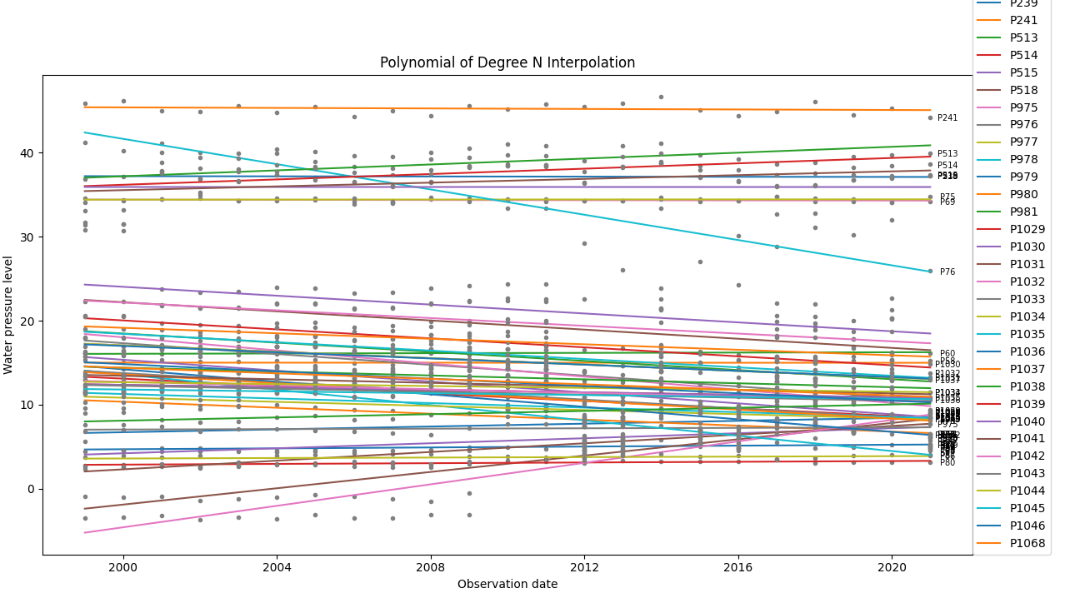
Least Square Smoothing Interpolation - METHOD: IDW
Figure shown Polynomial of Degree 2 → Method: Replaced by mean

Slide 25
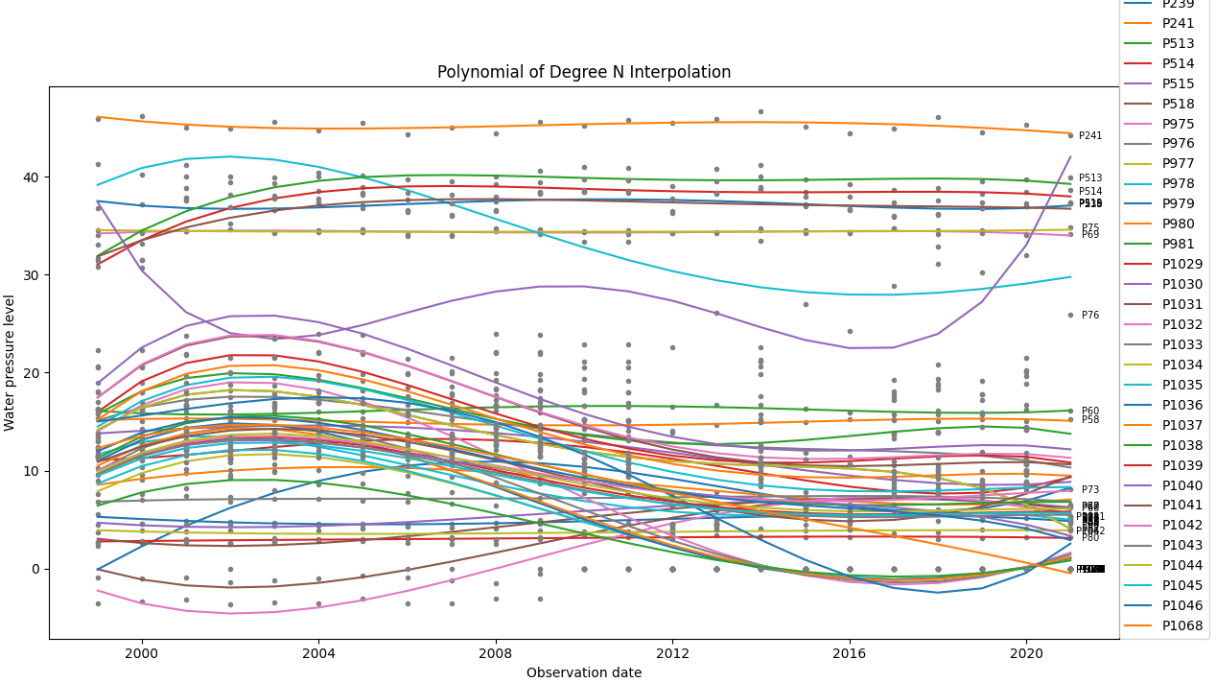
Least Square Smoothing Interpolation - METHOD: IDW
Figure shown Polynomial of Degree 5 → Method: Drop Empty

Slide 26
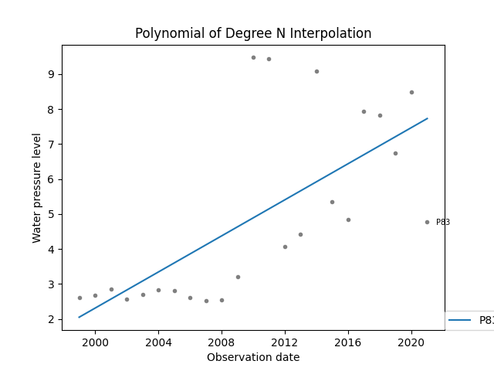
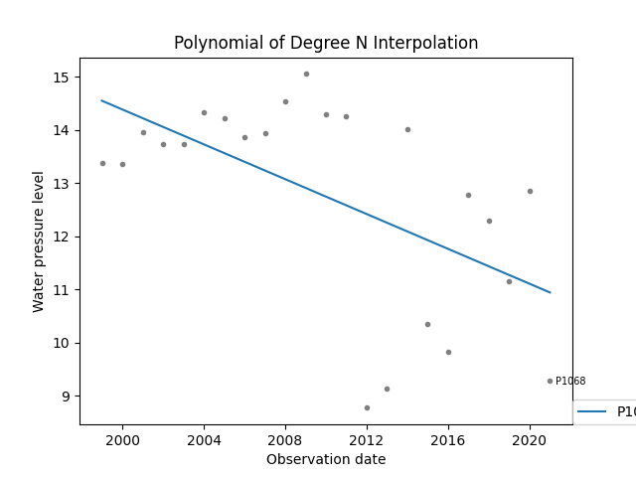
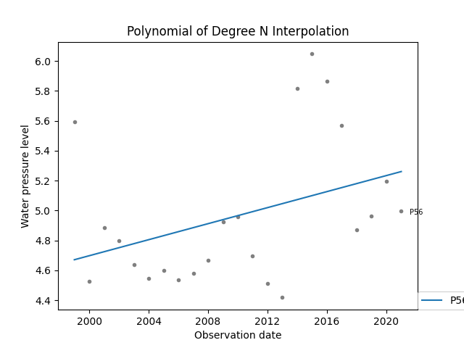
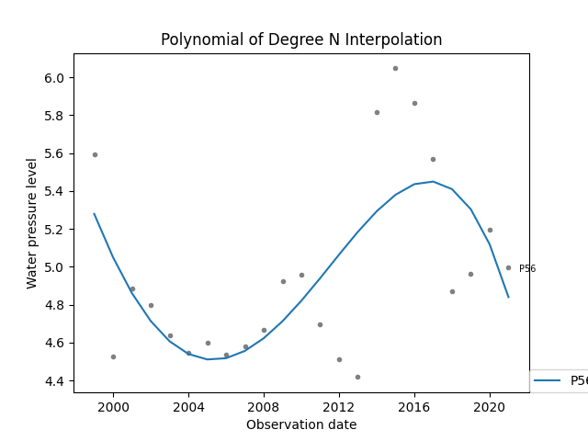
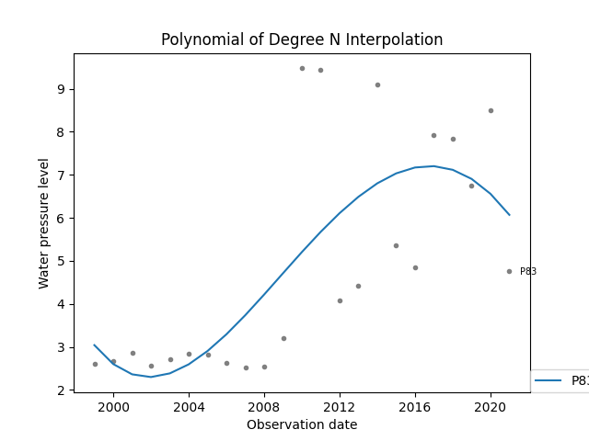
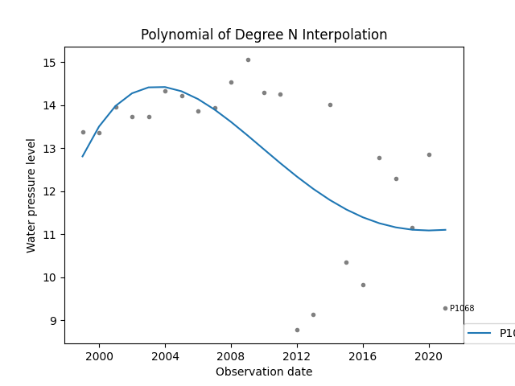
Least Square Smoothing Interpolation - METHOD: IDW
Degree 2
Degree 5
Station 56
Station 83
Station 83
Station 1068

Slide 27
Analysis - Least Square Smoothing Interpolation
Polynomial of Degree 2
Diversely, linear regression assumes a linear relationship between dependent and independent variables. That means it assumes that there is a straight-line relationship between them. However, Vibrating wire piezometers are used to monitor pore-water pressure in soils does not result in straight line graph measurement. In Conclusion, Polynomial of Degree N is NOT the best Solution for this case
Polynomial of Degree N (N > 2)
Polynomial models have poor interpolatory properties. High degree polynomials are notorious for oscillations between exact-fit values.
Polynomial models have poor extrapolatory properties. Polynomials may provide good fits within the range of data, but they will frequently deteriorate rapidly outside the range of the data.

Slide 28
Analysis - Least Square Smoothing Interpolation
Between Method drop_empty and replaced_by_mean, the lower the degree is, the effect of graph does not noticeable enough. But the higher the degree is, we can see more difference because the expression tries to satisfy each observation point
If the station has more missing value, the more differences that we might see
Example on station 56, missing value in 2005 and 2006

Slide 29
Analysis - Least Square Smoothing Interpolation
Seems like IDW data cleaning broke the pattern of pressure level (example on Station 66 which only have data from 1999 to 2009, pattern change extremely after 2009)
Station 1068, which has no value at first (before cleaning) as a comparison, might not answer writers need refers to what happened to station 66

Slide 30
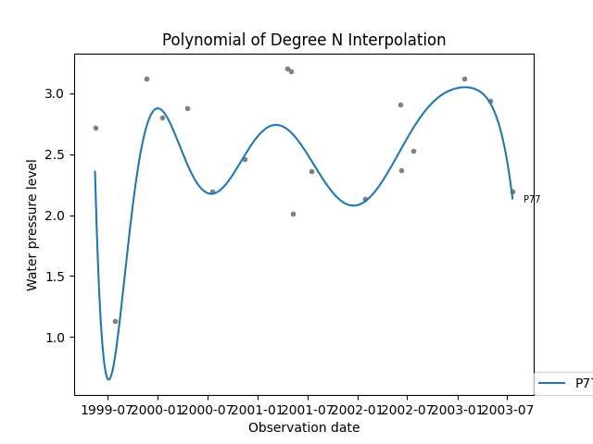
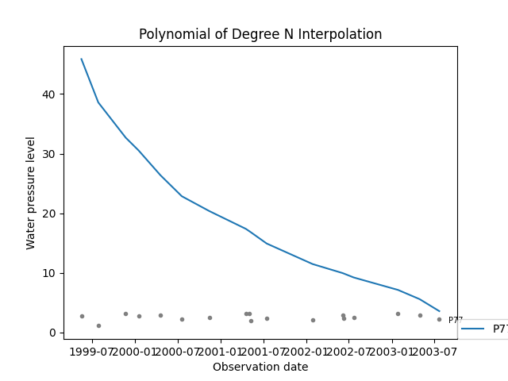
Exact Interpolation - polynomials of max degree = num of samples
Blocker:
Python script only could handle maximum size up to 40, however the complete data has 52 point
Station 72 has only 18 observation so it could met the criteria of calculation but when multiplication getting big, NaN value comes and return wrong calculation
Seems like size 10 -15 is the most satisfied the polynomial in each station
Degree 11 drop_empty
Max Degree
drop_empty
Station 83

Slide 31
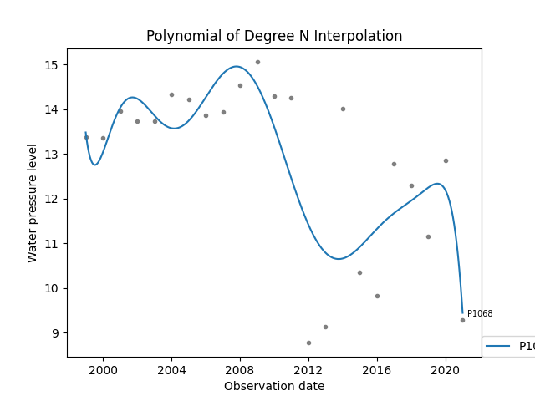
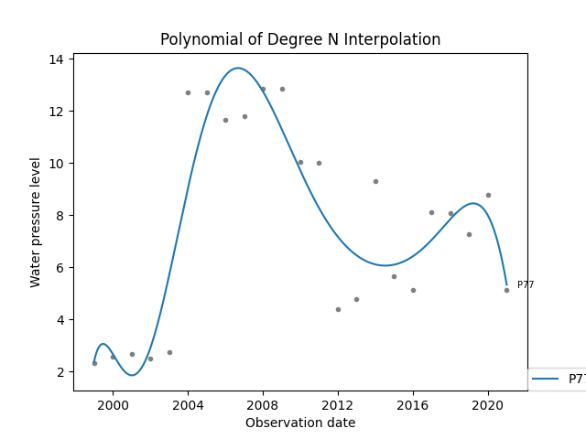
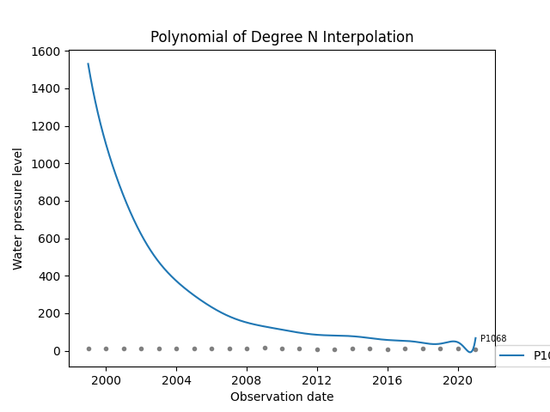
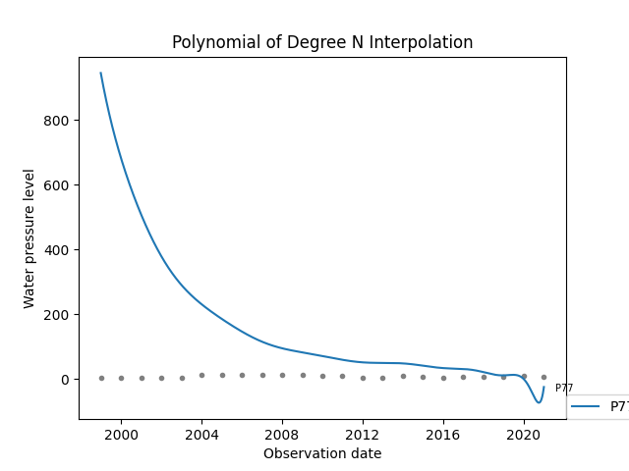
Exact Interpolation - polynomials of max degree = num of samples
Another example using IDW
Degree 10
Station 1068 IDW
Degree 10
Station 77 IDW
Max Degree
Station 1068 IDW
Max Degree
Station 77 IDW
Station 83

Slide 32
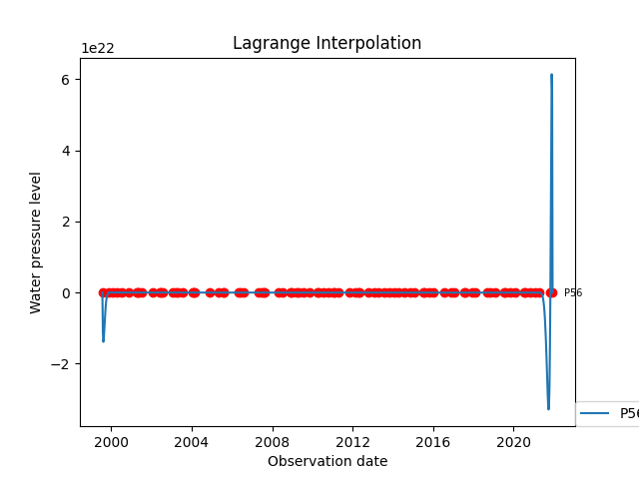
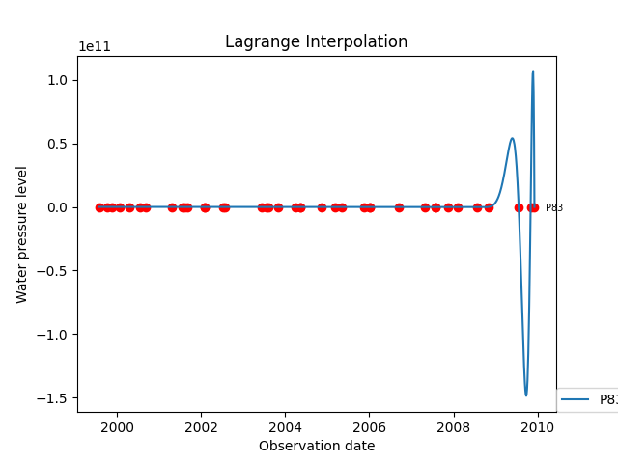
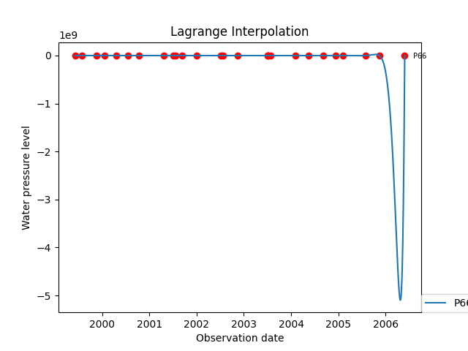
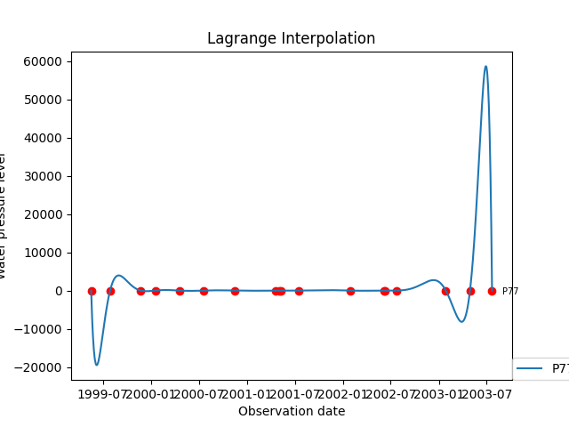
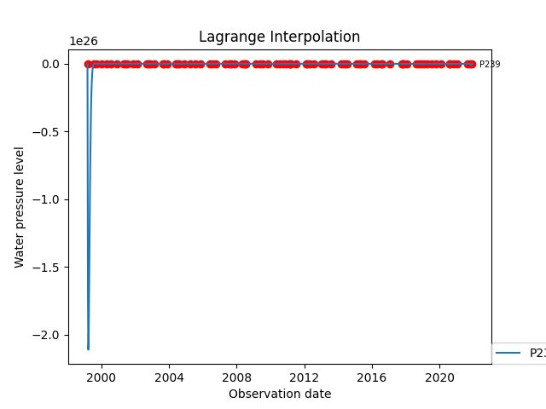
Exact Interpolation - Lagrange - METHOD: Drop Empty
Some example

Slide 33
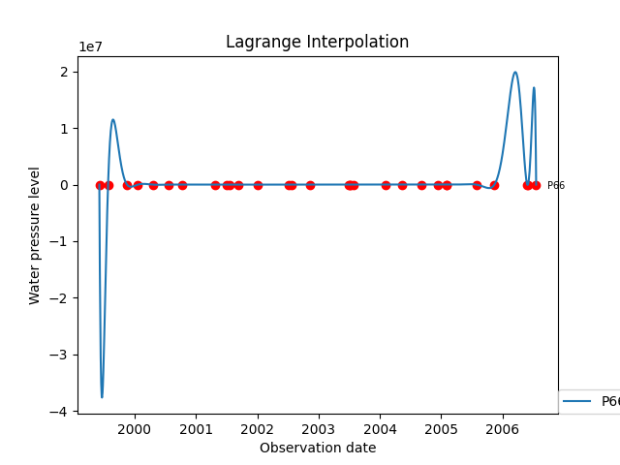
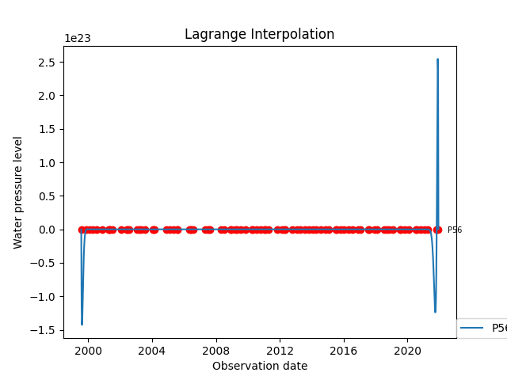


Exact Interpolation - Lagrange - METHOD: Replaced by Mean
Some example

Slide 34






Exact Interpolation - Lagrange - METHOD: IDW
Some example

Slide 35
Analysis - Exact Interpolation - Lagrange
Station 56 drop_missing
The higher number of observation acquisition, lagrange expression will try to satisfy each of observation point that result in an extreme high-low oscillation that could deliver a wrong interpolation
The higher number of observation acquisition will lead into a longer process of calculation
Even the lower total of observation IDW still bring a high/low oscillation (see figures example on station 56 (IDW) and station 56 (drop_missing)
Station 56 drop_missing

Slide 36
Analysis - Exact Interpolation - Lagrange
Station 66 drop_missing
Since replaced_by_mean method fill the empty value, it cause they prevent lagrange interpolation oscillation to be extreme because there is a point that need to be satisfied (while in drop_empty we assume it as empty). Example on station 66.
Drop missing can reach oscillation up to 1e9 while replaced_by_mean only 1e7
Station 66 replaced_by_mean

Slide 37






Piecewise Interpolation → Cubic
Drop Empty Replaced by Mean IDW
Station 83

Slide 38



Piecewise Interpolation → Cubic
Drop Empty Replaced by Mean IDW
Station 83

Slide 39






Piecewise Interpolation → Cubic → IDW
Station 83

Slide 40
Analysis - Piecewise Interpolation
Spline interpolation is preferred by Writers to polynomial interpolation because it yields similar results, even when using low degree polynomials, to avoid extreme high/low oscillation of polynomial of degree high n
It has smaller error compare to lagrange or polynomial (refers to the graph)
However, from IDW methods (example station 66) the data is broke after 2006. Similar issue happens to station > 519 which has no data at all. (this might be IDW has smaller reference after 2008s acquisition data

Slide 41






Spline Interpolation with Grid Knots
Drop Empty Replaced by Mean IDW
10 knots
20 knots

Slide 42






Spline Interpolation with Grid Knots
Drop Empty Replaced by Mean IDW
10 knots
20 knots

Slide 43

Analysis - Spline Interpolation with Grid Knots
The knots that writers implement is an equal spreaded knots
The higher number of knots, it will cause an extreme high/low oscillation like polynomials degree. If number of knots it not equal to the number of observation or knot observation point is not equal to date acquisition → smooth interpolation
If the number of knots is equal to the number of observation and the grid knot location is equal to acquisition date. it is similar with the piecewise interpolation → exact interpolation
Example using IDW on station 56 (figures on the right)

Slide 44
Challenges
Unfamiliarity with scripting tools Matlab or Python
The unfamiliar library to used for data analysis and
The script seems to be inefficiently typed that hold longer calculation process
Limited Array size ability to perform some interpolation method. Some value result in extremely high during calculation that cannot be saved even on float 64bit data type
Limited source to understand the data
From writer’s perspective, it is challenging to understand how the measurements works inside the Piezometer
Some website source of the data is provided in Italian, writer has limited time to understand the overview of the data by translating the page

Slide 45
Challenges
Challenge with data
Having wrong assumption during the process of the data, there are some external factors that are neglected for interpolating the data, such as assuming all missing values equal to the bore mean groundwater value,
The unknown pattern of ground water pressure. Writer does not know about the characteristic of Ground Water in Padua and how is their behaviour (its variation, etc). That is why the spline interpolation is used to see correlation between two points observation for developing interpolation function.
Different acquisition time. Most of the data ideally are being acquired 4 times a year, some are not. Writer does not get the details of how the data is being measured, how some external factors such as season, drought, affect the groundwater data. And each observed data is taken yearly 4 times in random dates

Slide 46
References
https://www.itl.nist.gov/div898/handbook/pmd/section8/pmd811.htm
https://www.sisgeo.com/uploads/schede/schede/VW_PIEZO_EN_05_vibrating_wire_piezometer.pdf (piezzometer)
GEOSPATIAL DATA ANALYSIST LABORATORY SESSION SLIDE
GEOSPATIAL DATA ANALYSIST - SLIDE

